Slide 1

AI Resume Builder by
Anuj Kumar
Welcome to the future of resume creation! Discover a platform that leverages AI to craft professional resumes that stand out in the competitive job market.

Slide 2
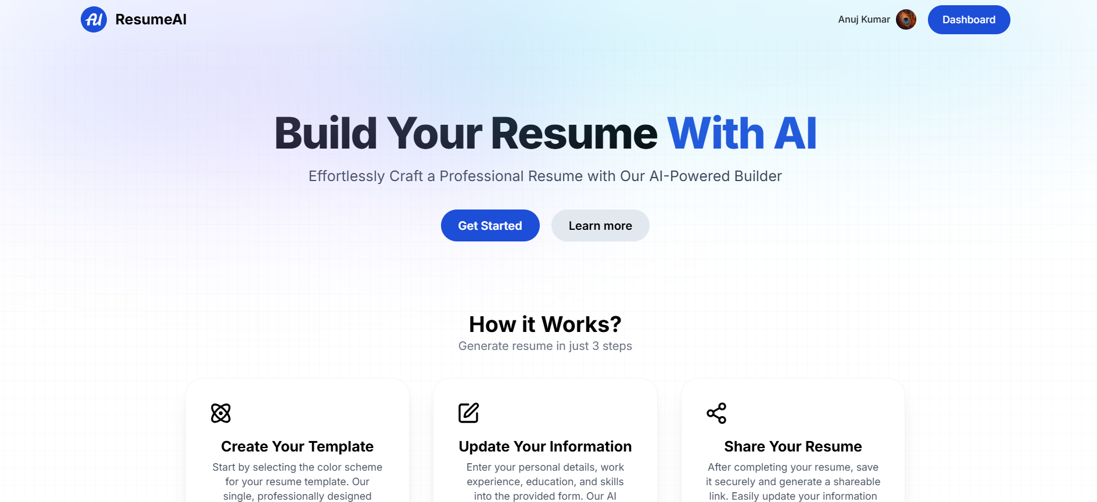
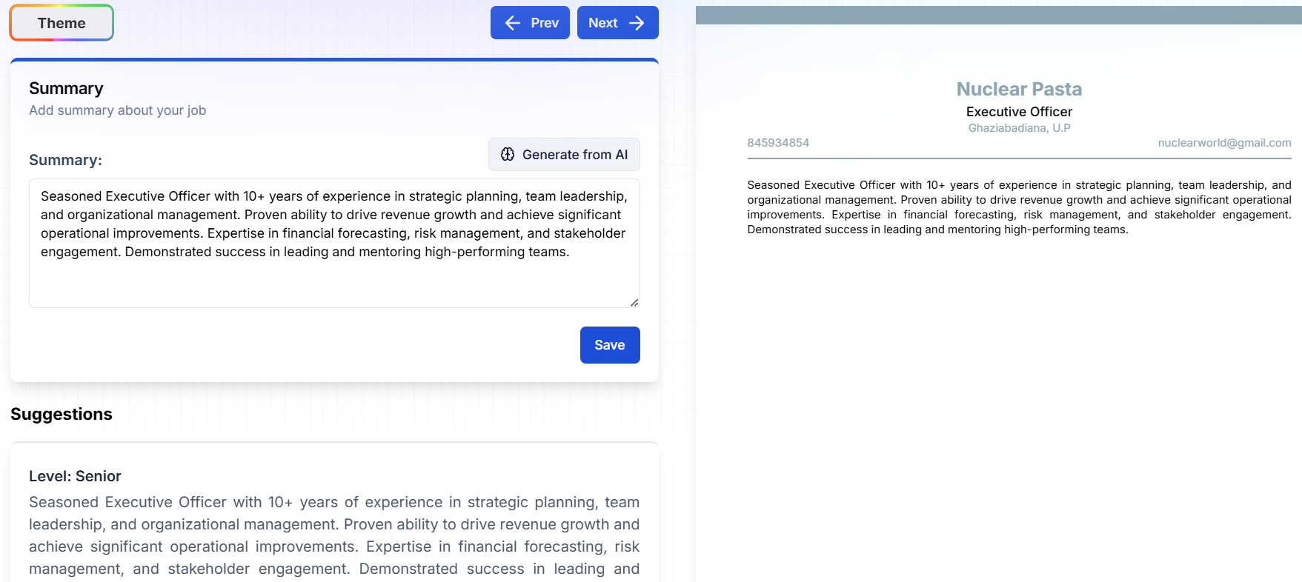
Introducing the Platform
Effortless Resume Creation
Unlock the Power of AI
Experience a seamless and user-friendly interface that guides you through every step, from selecting templates to optimizing your content.
Harness the advanced capabilities of Gemini API to generate impactful content, personalize your resume, and ensure ATS compatibility.

Slide 3

Leveraging Gemini API for AI-Driven Content
1
Smart Content Suggestions
2
Personalized Content Generation
Gemini API analyzes your skills and experience to suggest relevant keywords and phrases, enhancing the impact of your resume.
The AI generates tailored content based on your input, helping you craft a compelling narrative that resonates with recruiters.
3
Grammar and Style Optimization
Gemini API ensures your resume is grammatically flawless and adheres to industry standards, making a strong first impression.

Slide 4

Enhancing User Experience with React
Dynamic Interface
Seamless Navigation
React powers a responsive and interactive platform, providing a smooth and engaging experience for users.
React ensures effortless transitions between different sections of the platform, making resume creation a breeze.
Real-time Updates
Changes you make are reflected instantly, allowing for immediate feedback and iterative refinement of your resume.

Slide 5
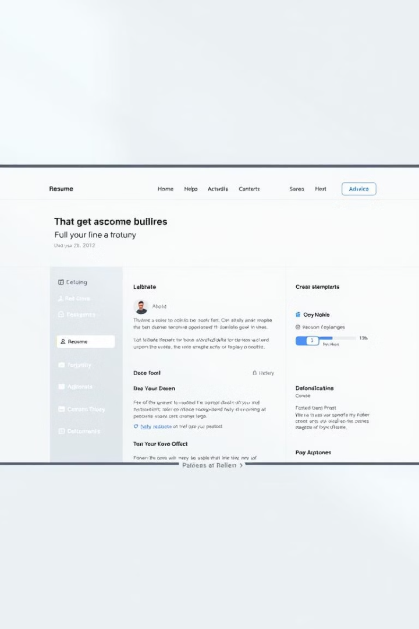


Designing with TailwindCSS
Customizable Templates
TailwindCSS enables users to personalize their resumes with a wide range of customizable templates, ensuring a professional and unique look.
Design Flexibility
TailwindCSS empowers users to adjust colors, fonts, and layouts, creating a visually appealing resume that aligns with their preferences.
Cross-Device Compatibility
TailwindCSS guarantees a consistent and polished appearance across different devices, ensuring a positive user experience.

Slide 6

Secure Authentication with Clerk
1
Secure User Accounts
Clerk provides a robust and secure authentication system, protecting user data and ensuring privacy.
2
Seamless Sign-In
Users can easily sign in with their preferred methods, including social media accounts, for convenient access.
3
Data Privacy
Clerk prioritizes data security and privacy, adhering to industry standards and ensuring compliance with regulations.

Slide 7
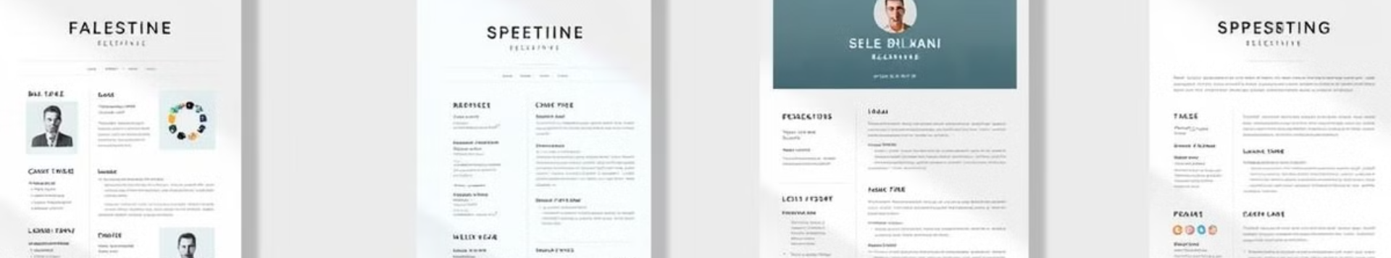



Personalized Resume Templates
Wide Selection
Customization Options
Pre-Built Sections
Choose from a curated library of professional templates designed to highlight your unique skills and experience.
Customize the templates to match your personal brand and desired style, tailoring your resume to specific job applications.
Templates feature pre-built sections for common resume elements, streamlining the creation process and ensuring consistency.

Slide 8



Optimized Resume Generation
AI-Driven Optimization
1
The AI analyzes your content and adjusts keywords, phrases, and formatting to ensure ATS compatibility and maximize visibility.
Tailored Formatting
2
The platform formats your resume according to industry best practices, ensuring a professional and easy-to-read layout.
Applicant Tracking System (ATS) Compatibility
3
Resumes are automatically formatted to be compatible with Applicant Tracking Systems, increasing the chances of getting noticed.

Slide 9
Flexible Sharing and Download Options
Download Formats
1
Download your resume in various formats (PDF, Word, etc.) for easy sharing and submission.
Direct Sharing
2
Share your resume directly from the platform to social media, email, or job application portals.
Cloud Storage
3
Store your resumes securely in the cloud, allowing you to access them anytime, anywhere.

Slide 10
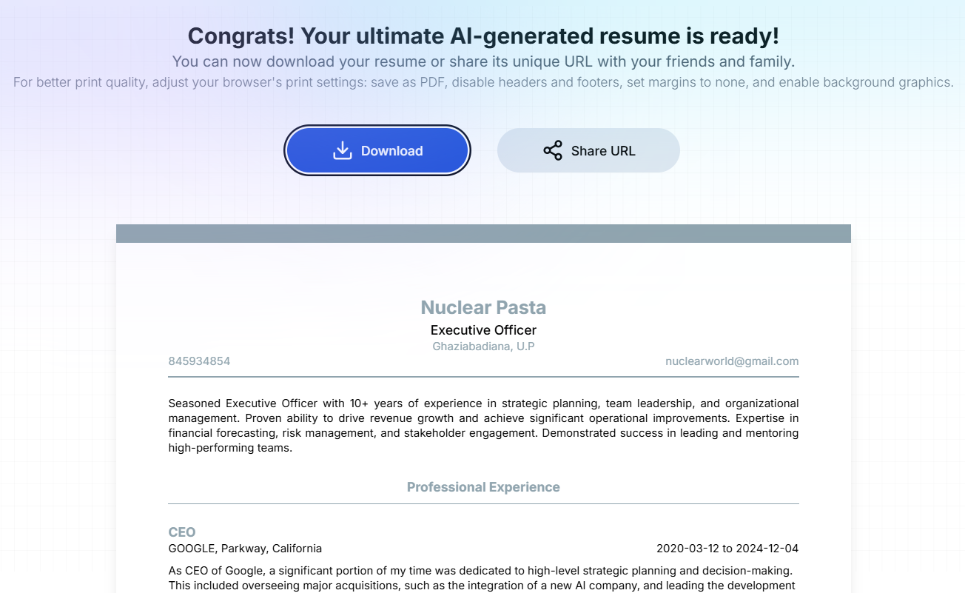
Delivering ATS-Friendly Resumes
1
Keyword Optimization
The AI identifies relevant keywords and strategically places them throughout your resume, ensuring it gets picked up by ATS.
2
Structured Formatting
Resumes are formatted according to ATS requirements, with consistent headings, sections, and spacing for easy scanning.
3
Targeted Content
Gemini API analyzes job descriptions and suggests relevant content, ensuring your resume aligns with the specific requirements.

